Slide 1
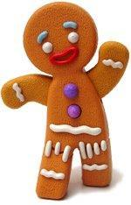
The Gingerbread Man
A Cedar Ridge Primary Story

Slide 2
 | Once upon a time lots of people worked at Cedar Ridge Primary. One day a cook made a gingerbread man. He gave him chocolate chips for eyes and gumdrops for buttons. He put him in the oven to bake.

Slide 3
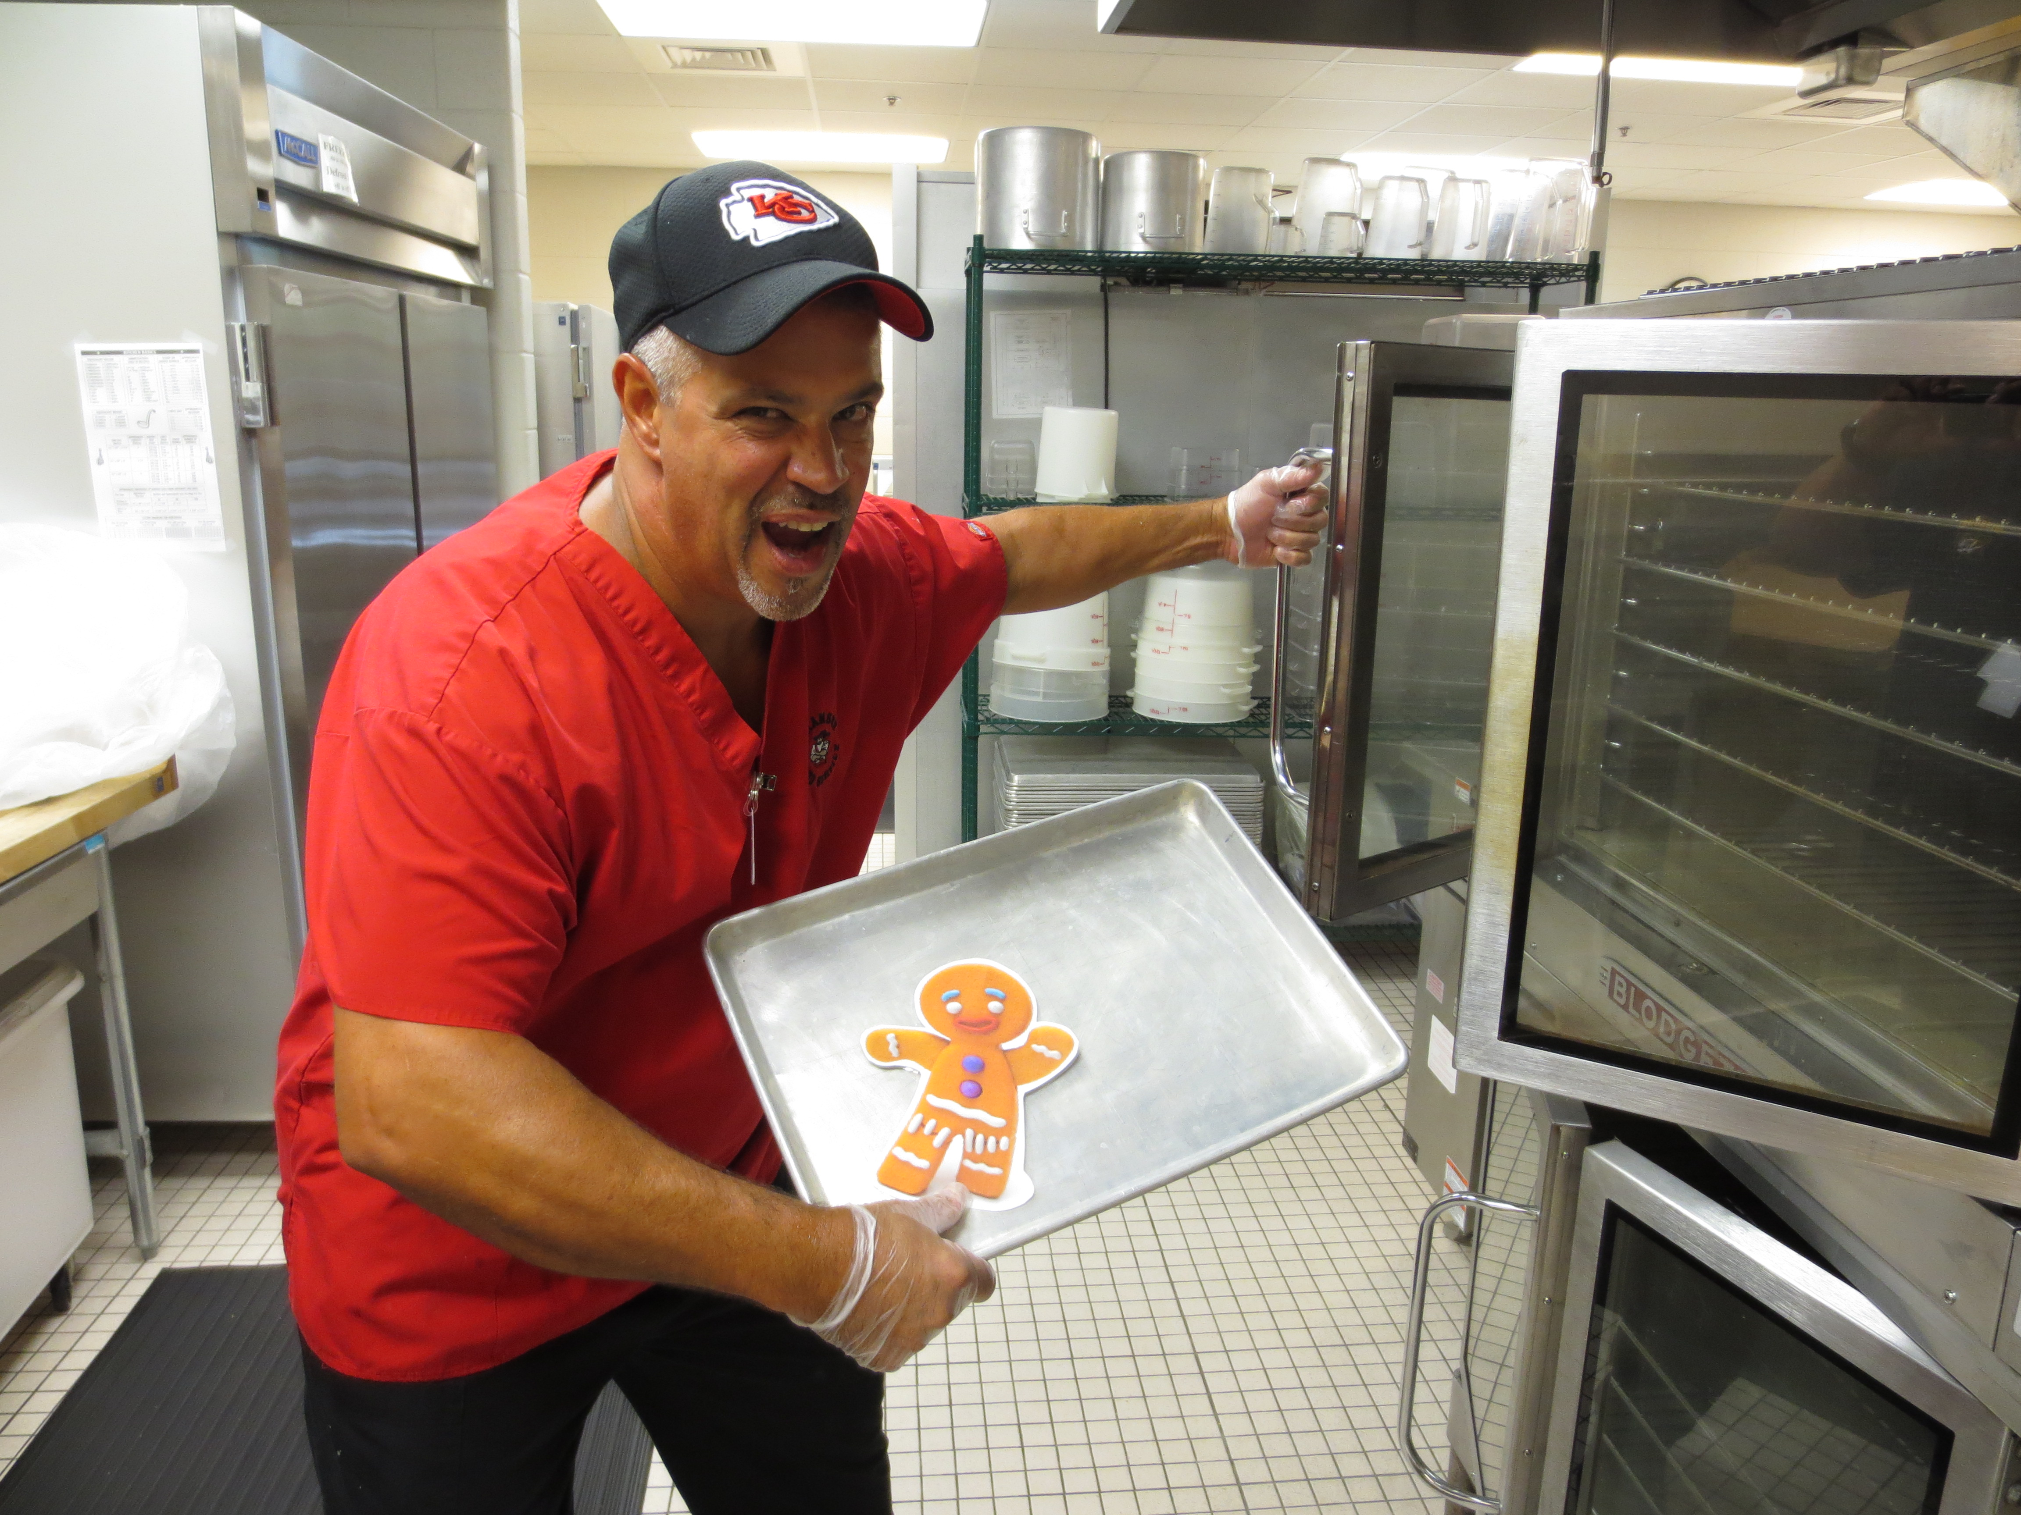
 | The cook and other school staff were very hungry and wanted to eat the gingerbread man. As soon as he was cooked, the cook opened the oven door. The gingerbread man jumped out into the kitchen and ran, shouting, “Don't eat me!”

Slide 4
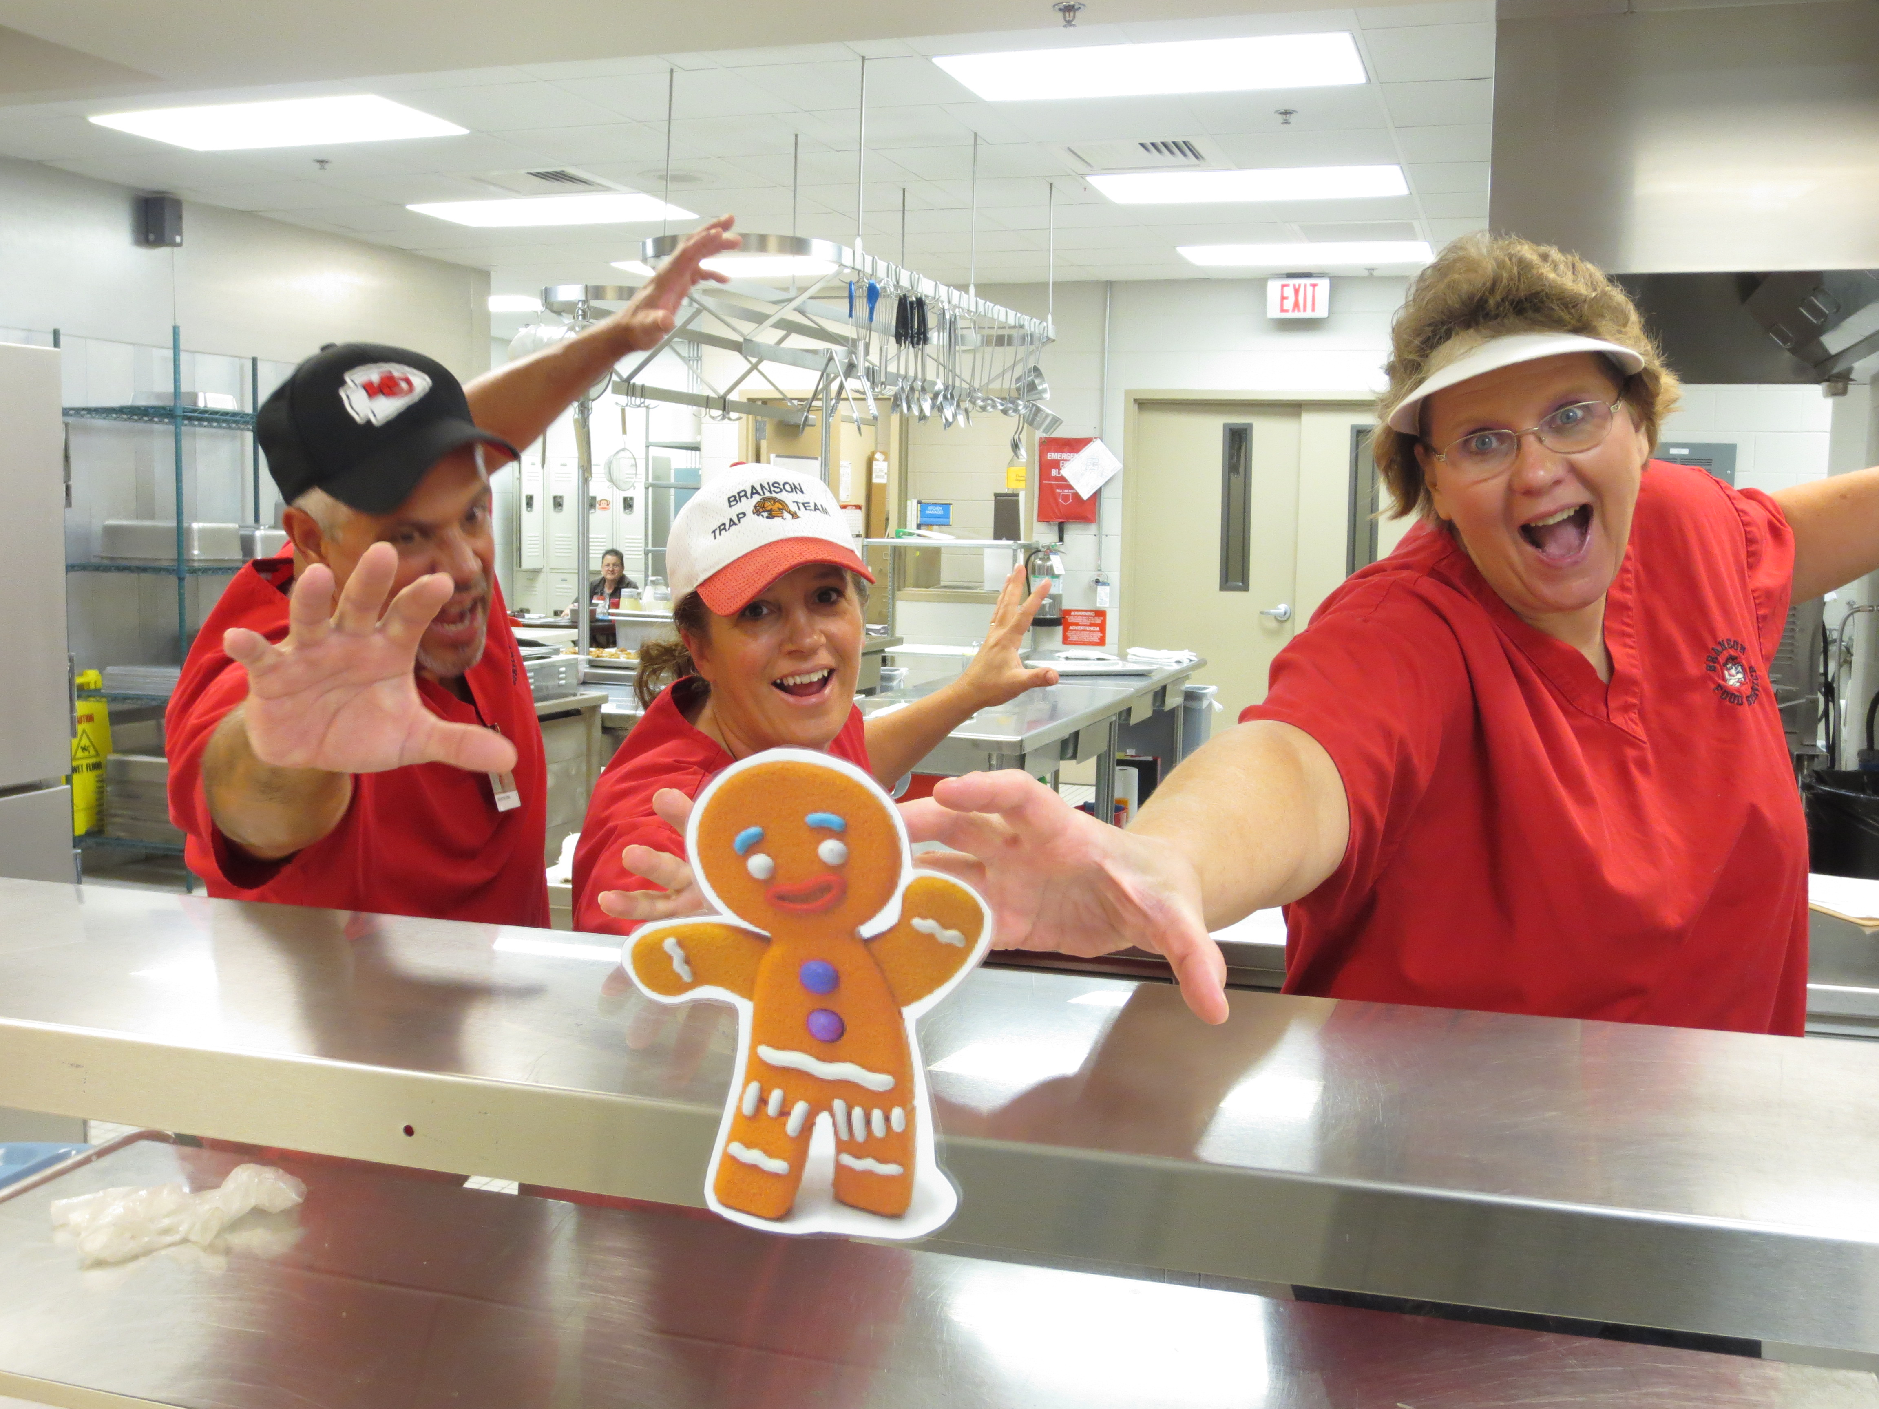
 | All the cooks ran after the gingerbread man. “Stop! Stop!” they yelled. The gingerbread man did not look back. He ran on saying, “Run, run as fast as you can! You can't catch me, I'm the gingerbread man!”

Slide 5
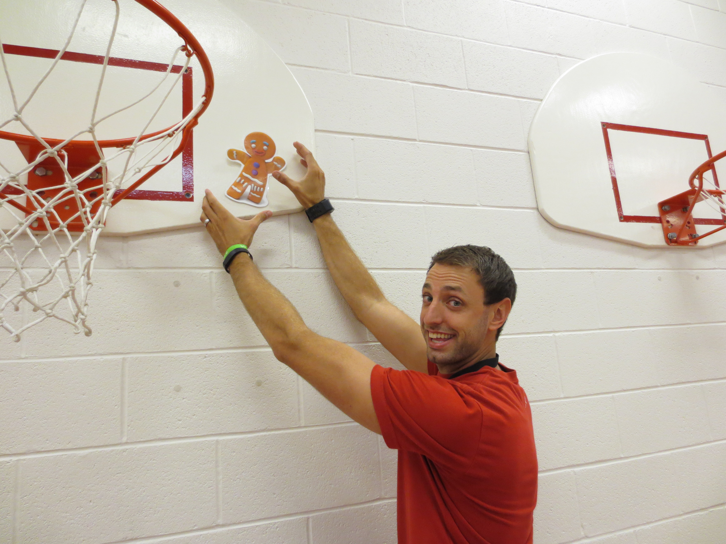
 | Down the stairs he sped when he came to the gym. “Stop! Stop! I would like to eat you," shouted the coach. The gingerbread man was too fast. He ran on saying "Run, run as fast as you can. You can't catch me, I'm the gingerbread man.”

Slide 6
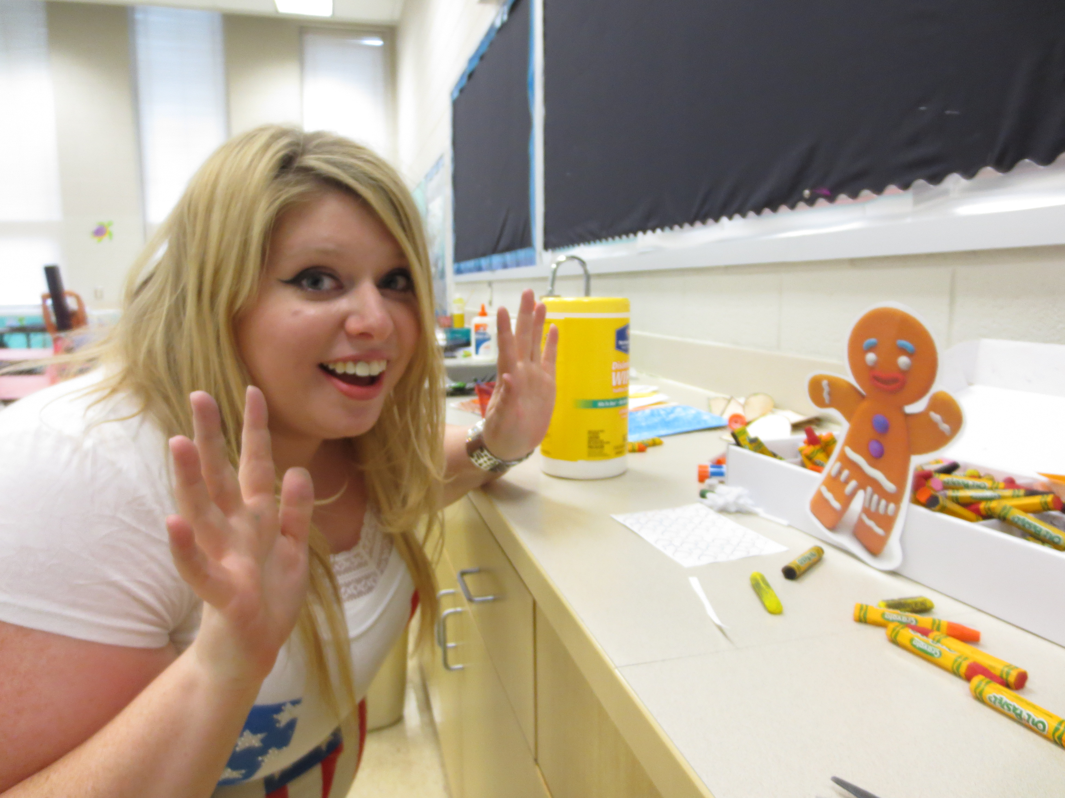
 | Back up the stairs he sped when he came to the Art room. “Stop! Stop! I would like to eat you," shouted the art teacher. The gingerbread man was too fast. He ran on saying "Run, run as fast as you can. You can't catch me, I'm the gingerbread man.”

Slide 7
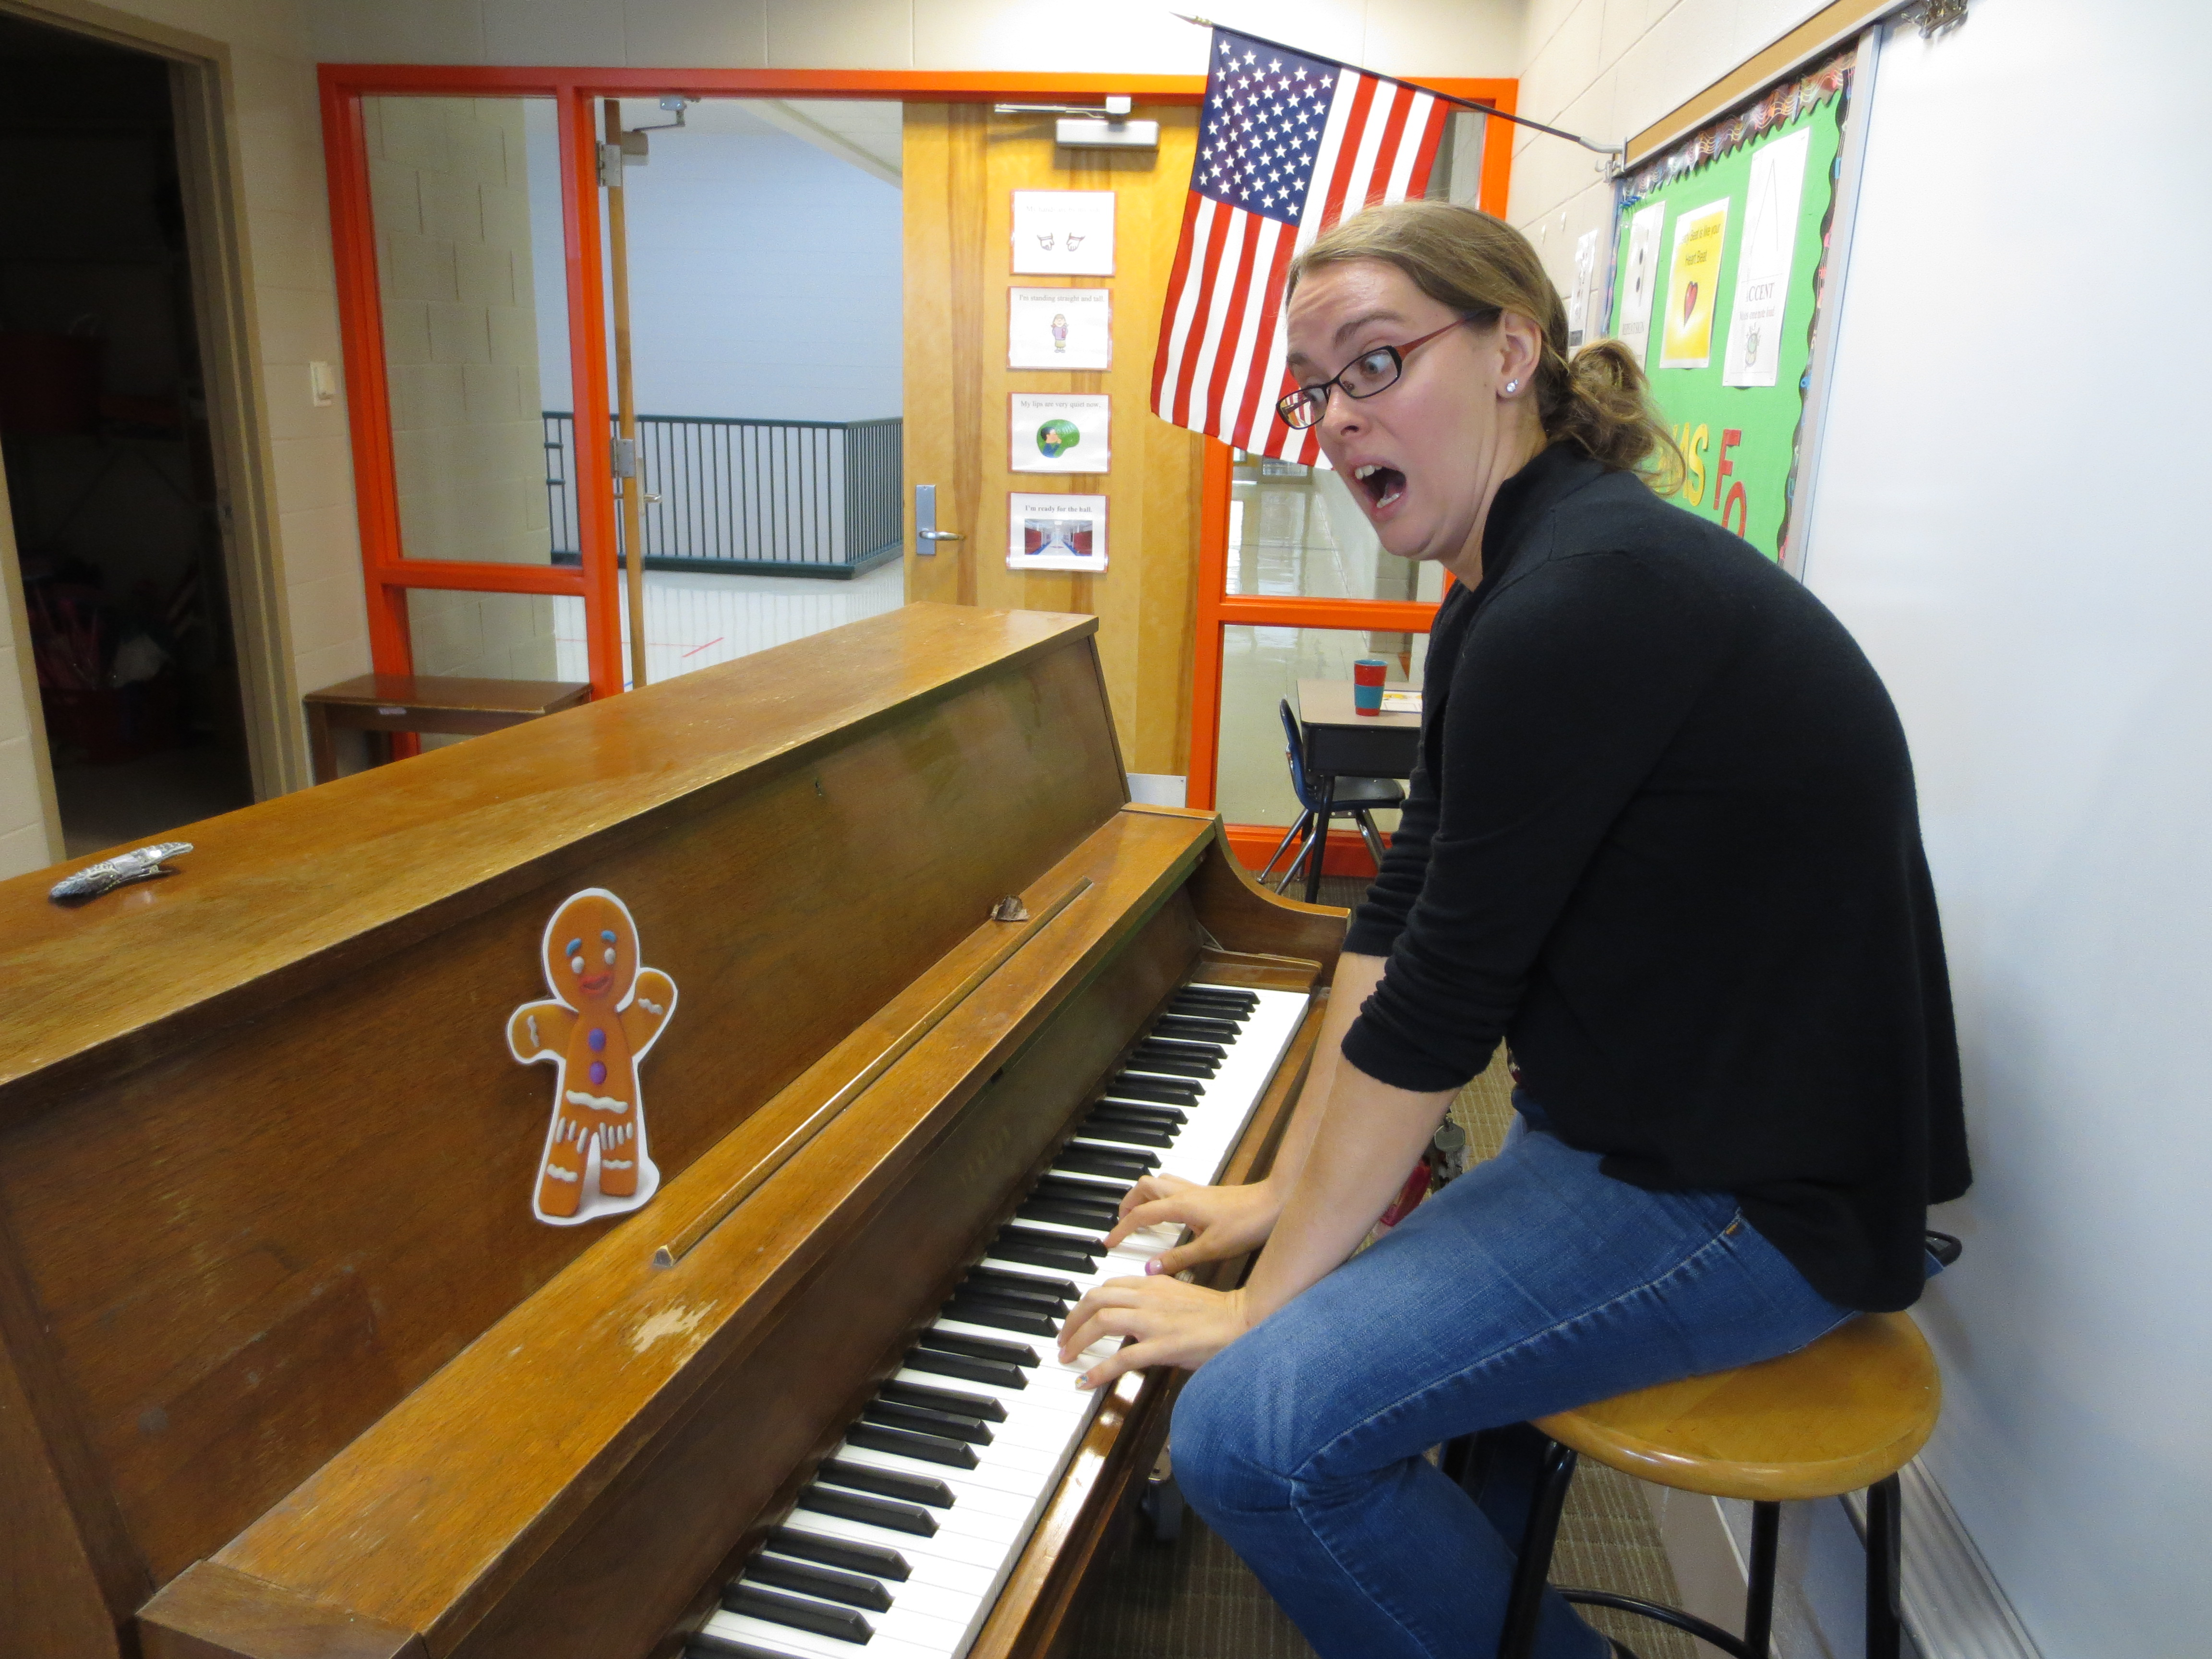
 | He ran out the door and into the Music room. “Stop! Stop! I would like to eat you," shouted the music teacher. The gingerbread man was too fast. He ran on saying "Run, run as fast as you can. You can't catch me, I'm the gingerbread man.”

Slide 8
 | He sped out the door and into the Library. “Stop! Stop! I would like to eat you," whispered the librarian. The gingerbread man was too fast. He ran on saying "Run, run as fast as you can. You can't catch me, I'm the gingerbread man.”

Slide 9
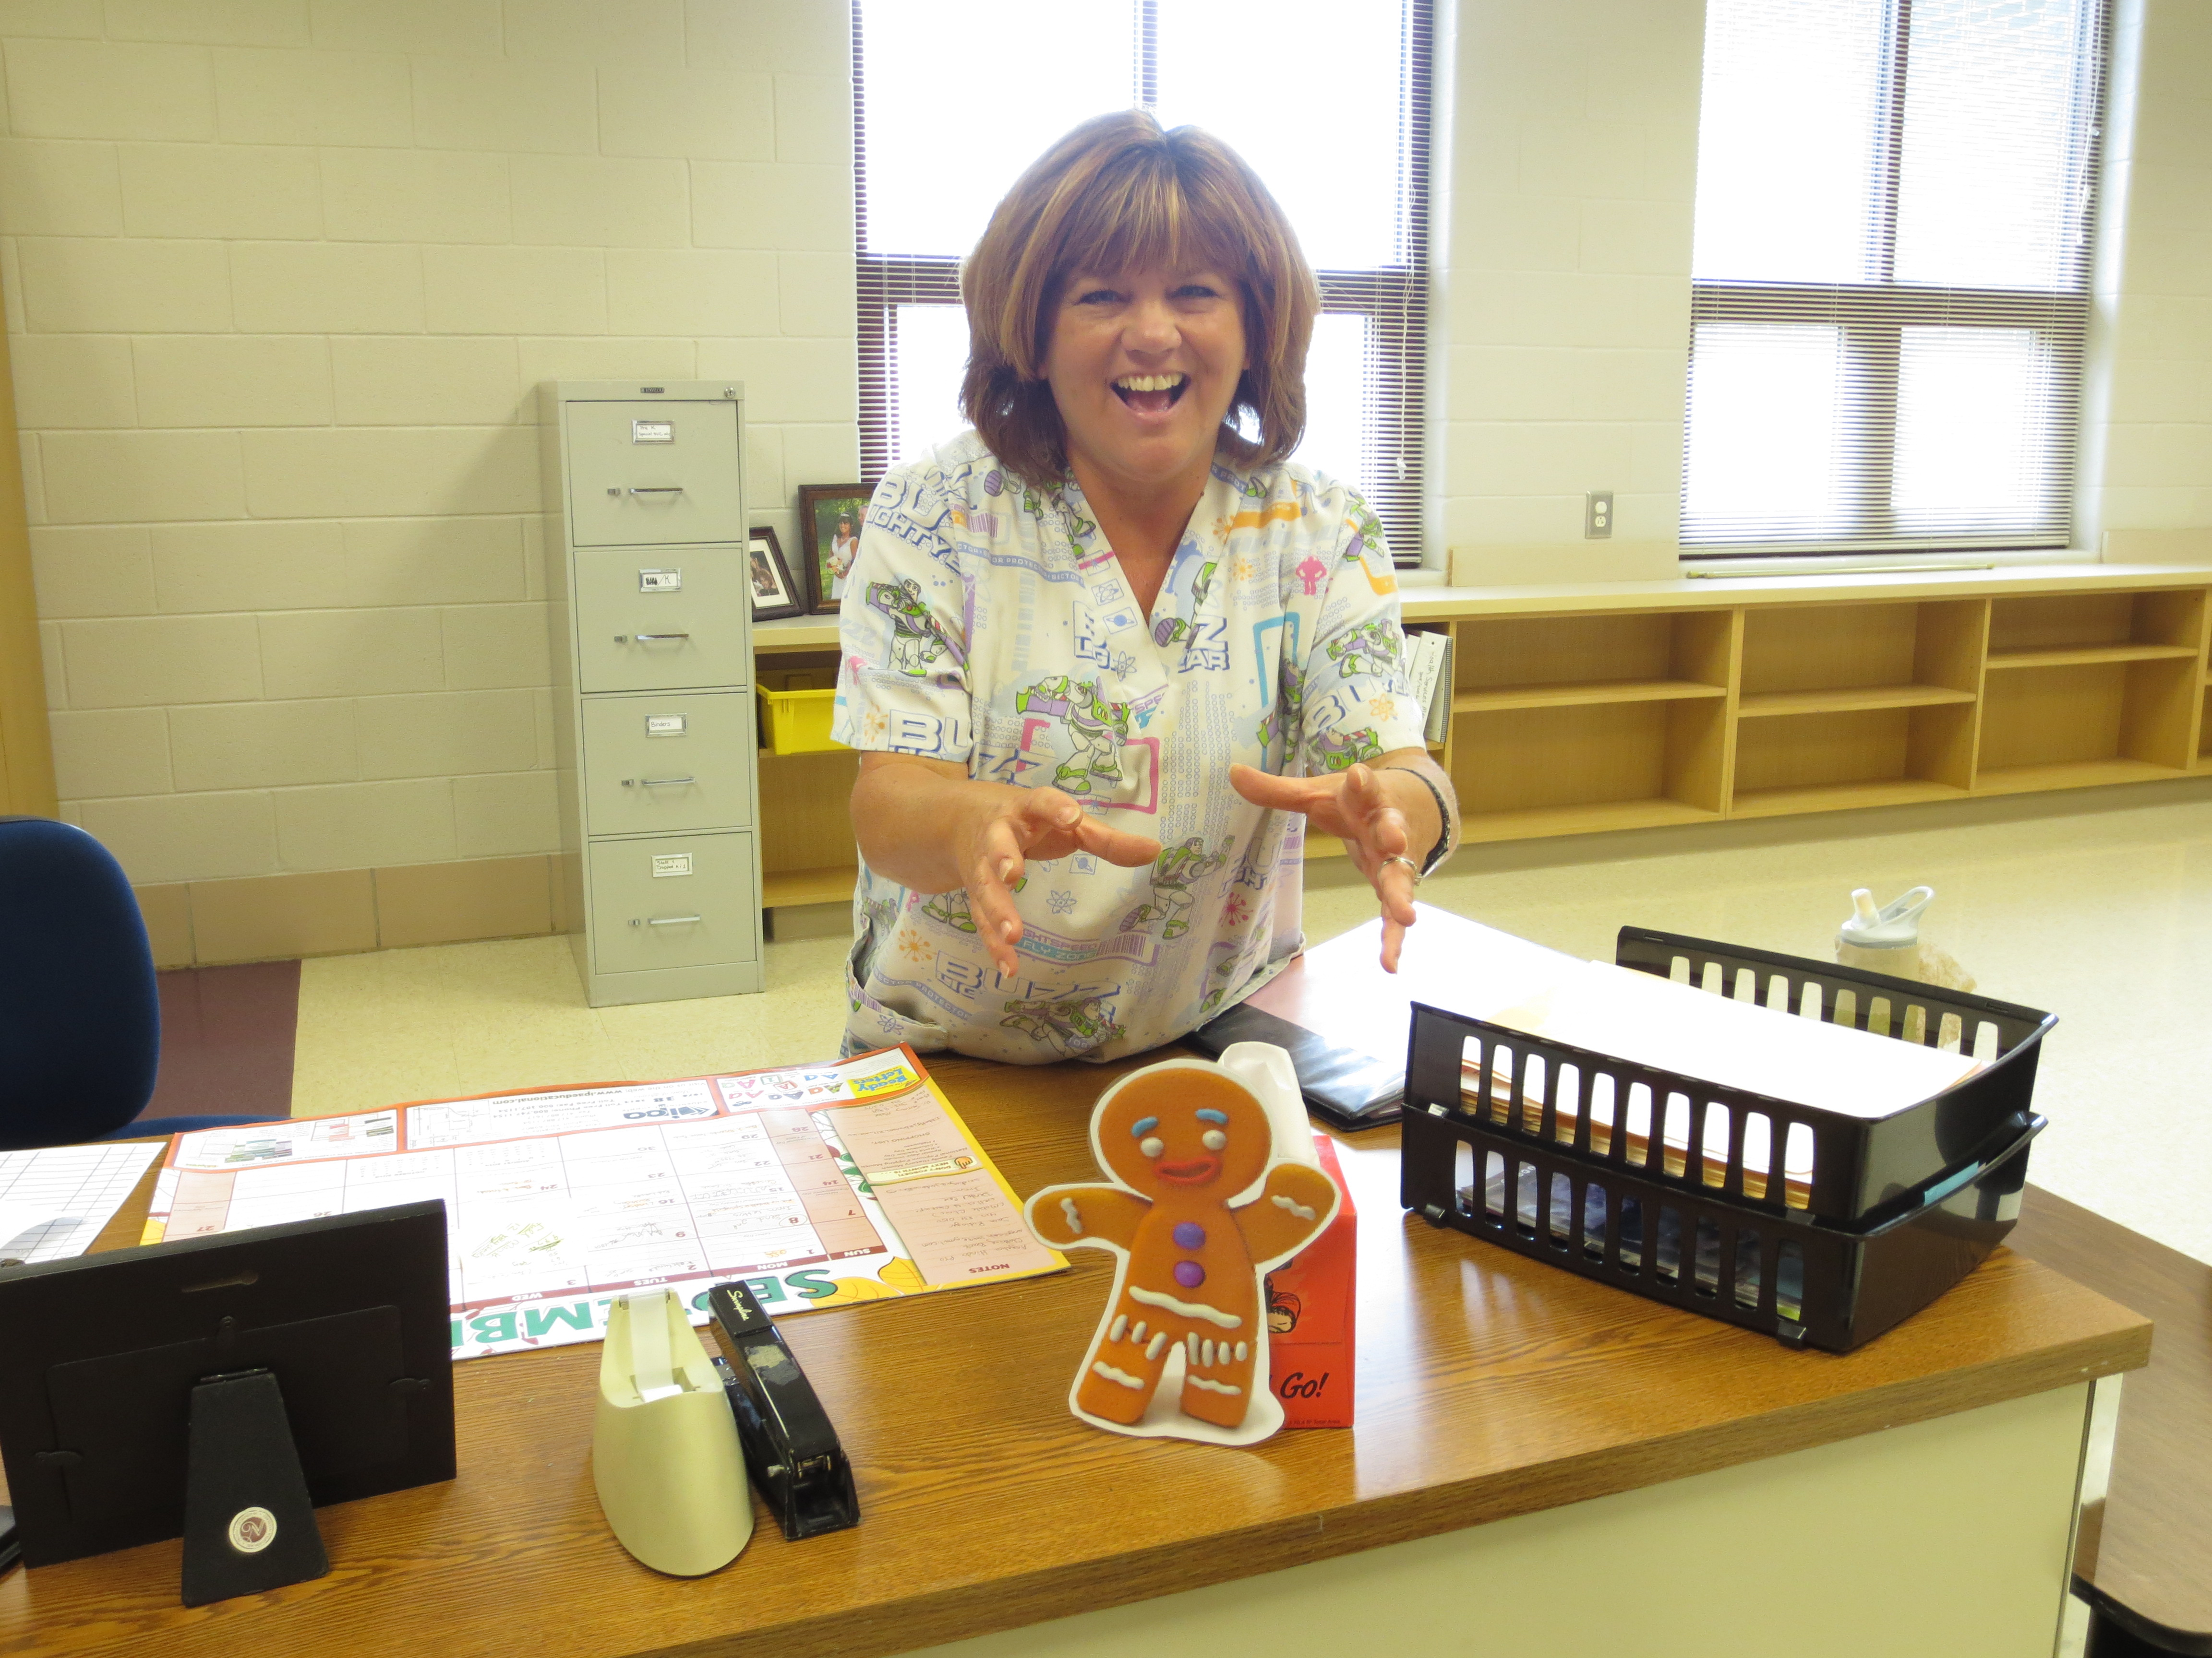
 | Through the cafeteria and down the hallway he sped when he came to the nurses’ office. “Stop! Stop! I would like to eat you," shouted the nurse. The gingerbread man was too fast. He ran on saying "Run, run as fast as you can. You can't catch me, I'm the gingerbread man.”

Slide 10
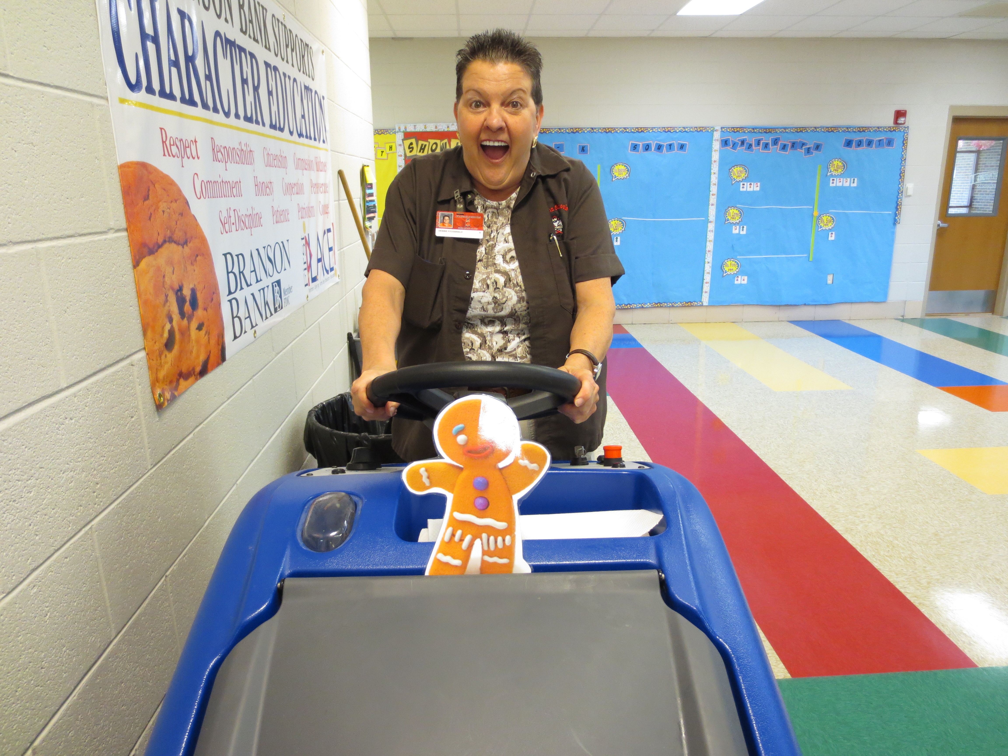
 | A little further down the hallway he met a janitor. “Stop! Stop! little man,” yelled the janitor, “I want to eat you.” Again the gingerbread man was too fast. He sped on down the hallway saying, "Run, run as fast as you can. You can't catch me, I'm the gingerbread man."

Slide 11
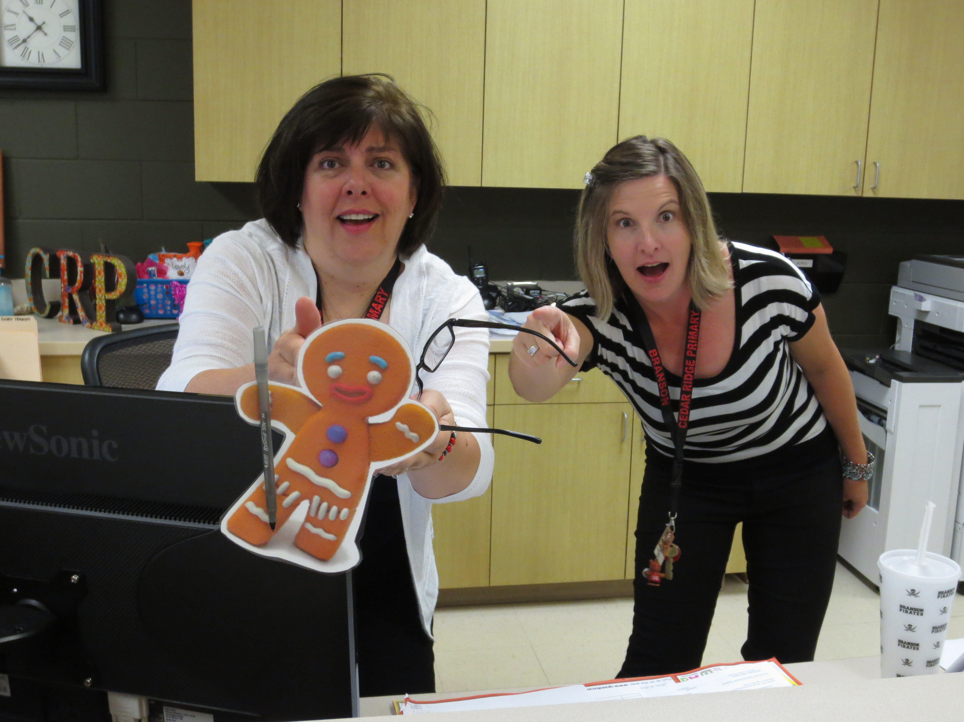
 | It was not long before the gingerbread man came to the front office. “Stop! Stop!” shouted the secretaries. “I want to eat you, little man.” But the gingerbread man did not stop. He said, ”Run, run as fast as you can. You can't catch me, I'm the gingerbread man.”

Slide 12
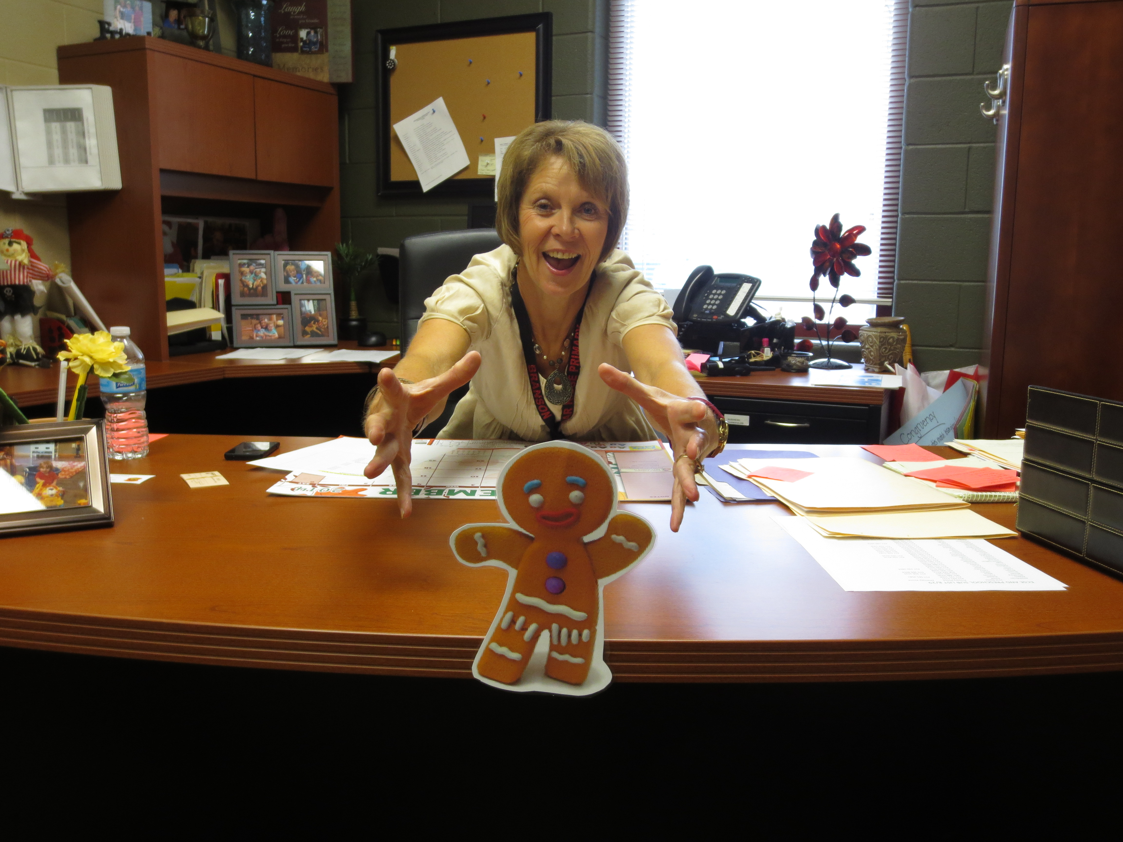
 | The principal joined in the chase. “Stop, stop” the principal shouted. “I want to eat you too!” The gingerbread man laughed and laughed, until he came to a dead end. “Oh no!” he cried, “They will catch me. How can I get away?”

Slide 13
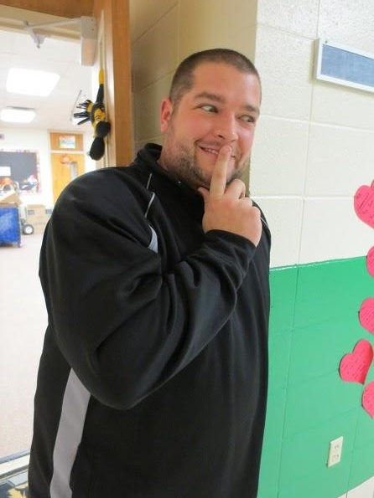
 | A sly counselor came down the hallway. “I can help you get away,” said the counselor. “Jump on to my shoulder and they won’t see you.” “You won't eat me, will you?” said the gingerbread man. “Of course not,” said the counselor.

Slide 14
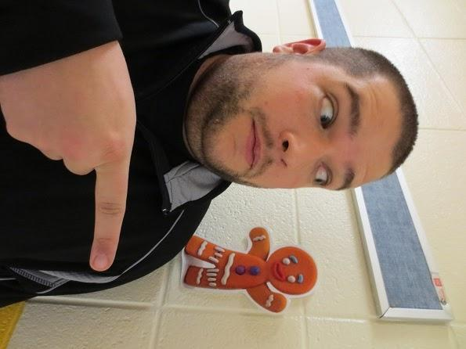
 | The gingerbread man climbed on the counselor’s shoulder. Soon the gingerbread man began to get nervous. “Hide in my room” said the counselor. So the gingerbread man did. As they walked the counselor said, “I can still see you. Hide on my wall.” So the gingerbread man did as he was told.

Slide 15
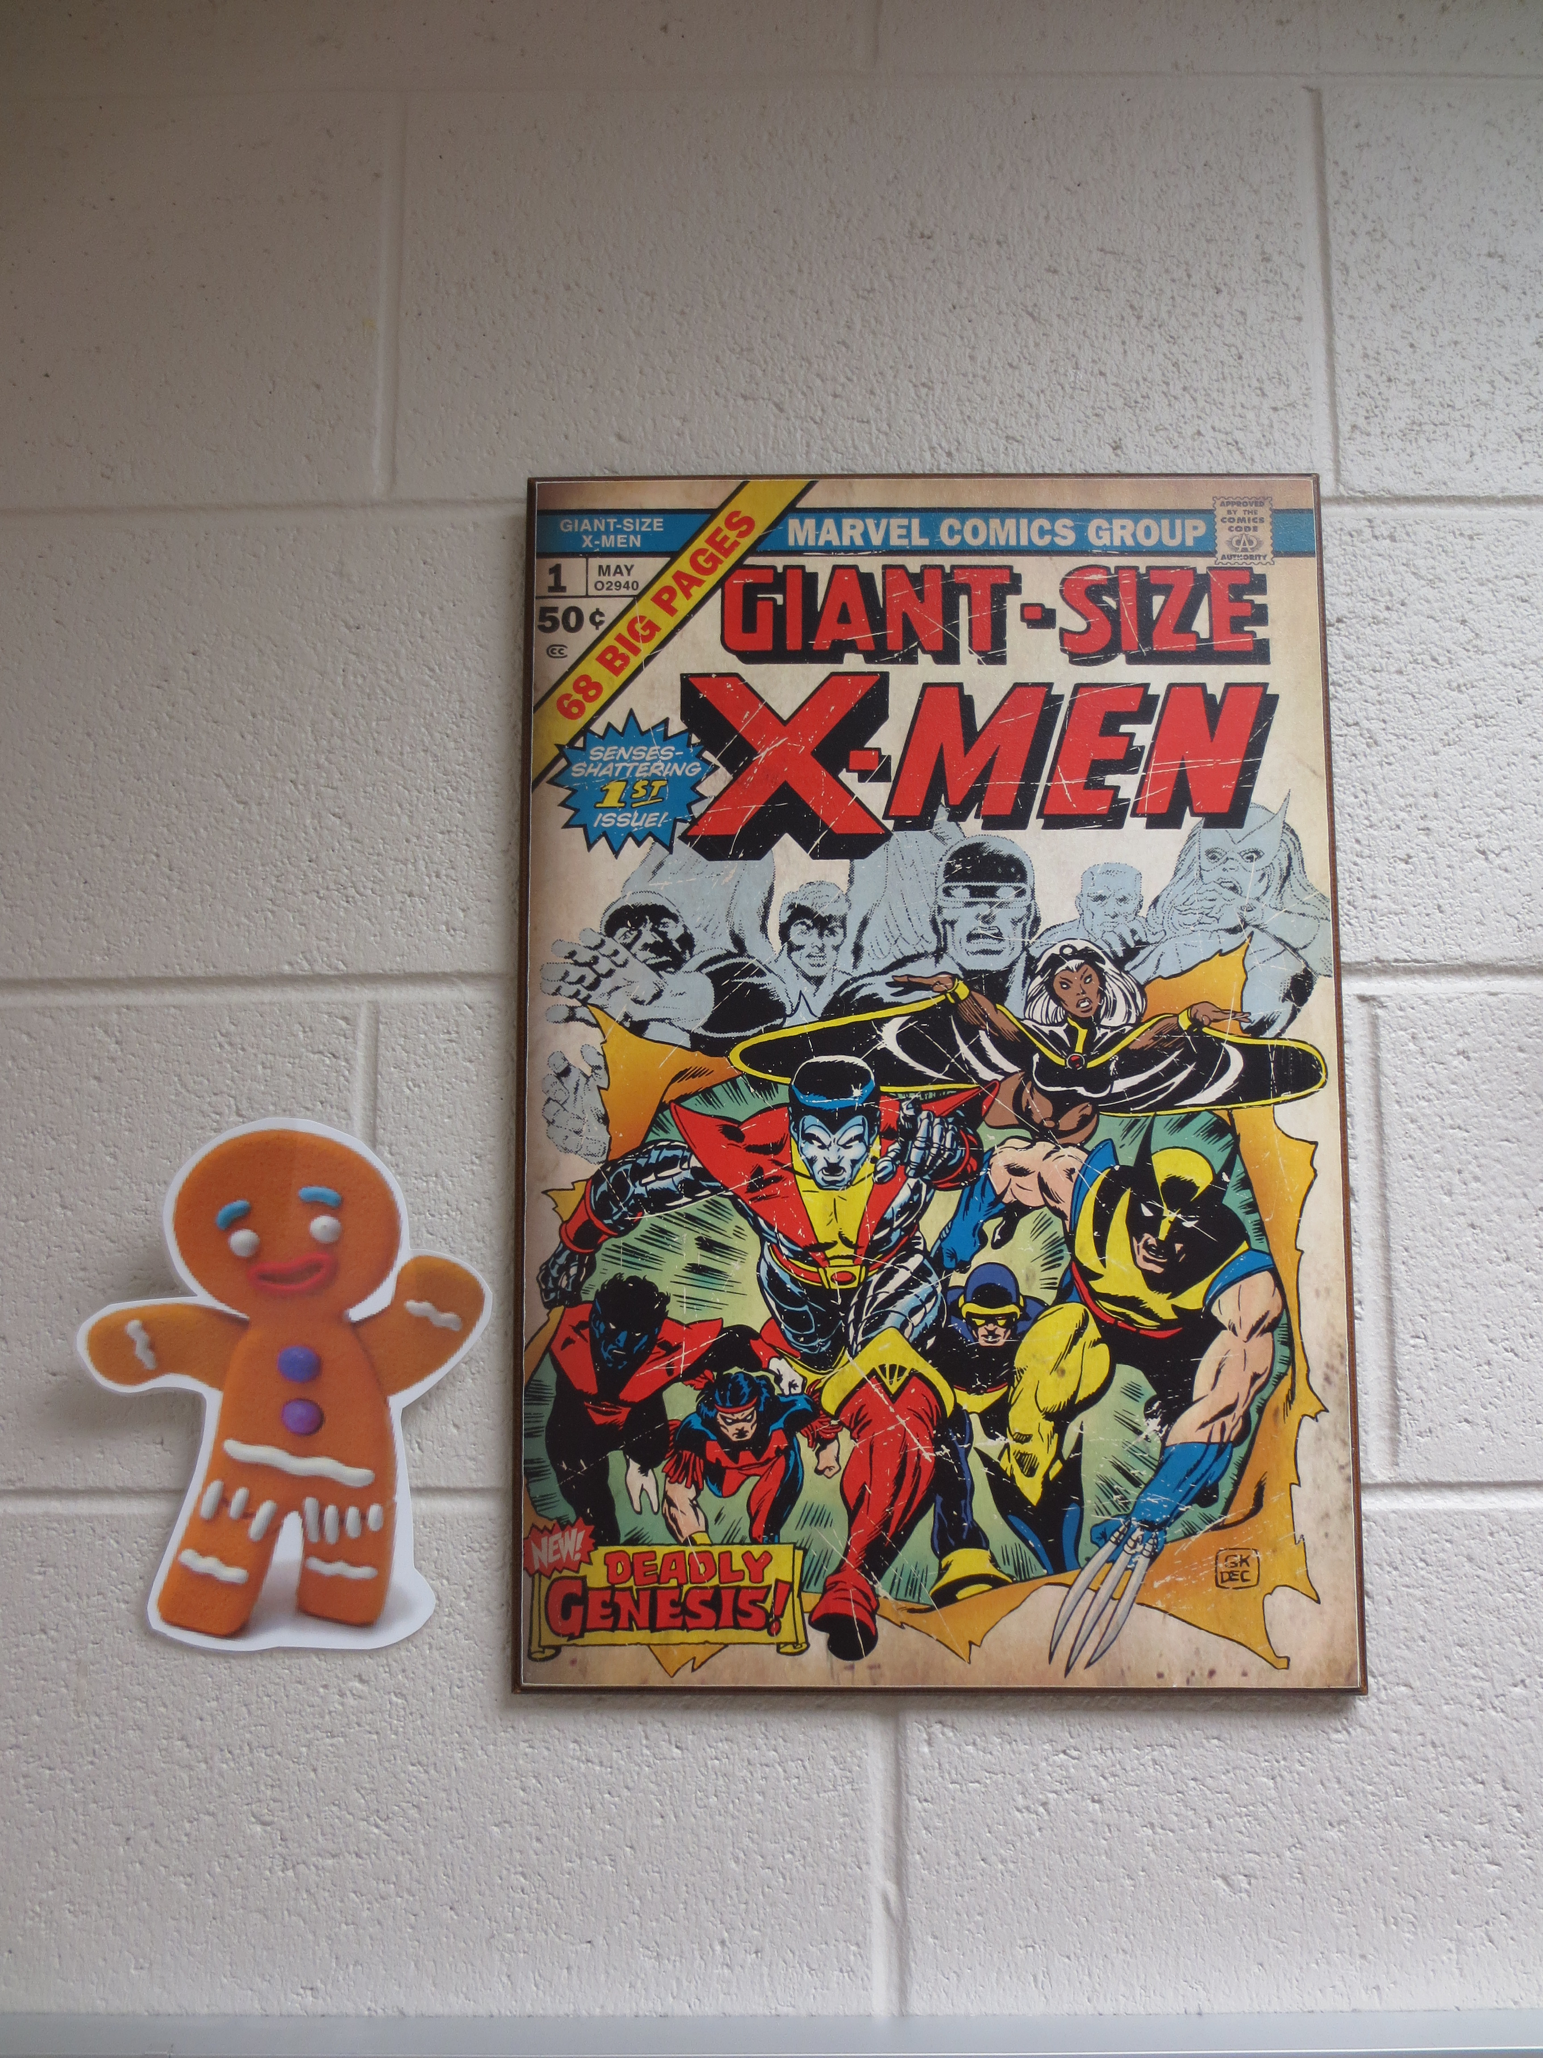
 | And that is where you can find the Gingerbread Man today, on the counselor’s wall, helping the Cedar Ridge Primary students learn about jobs in the Primary building!

